Slide 1
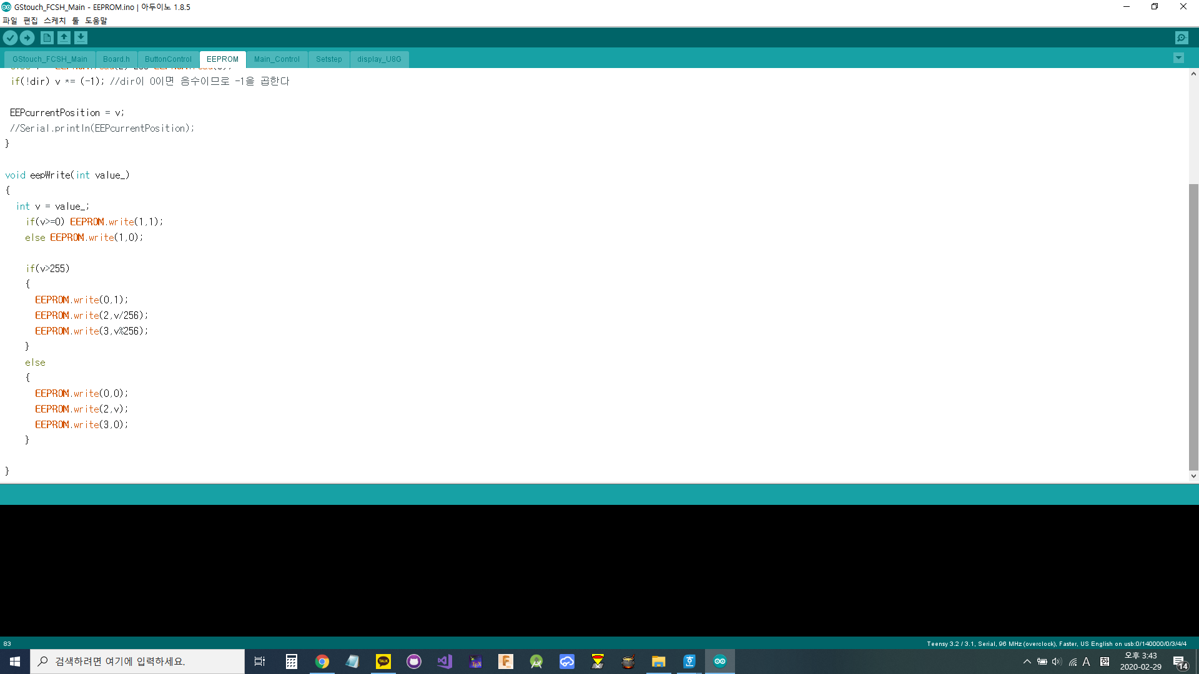
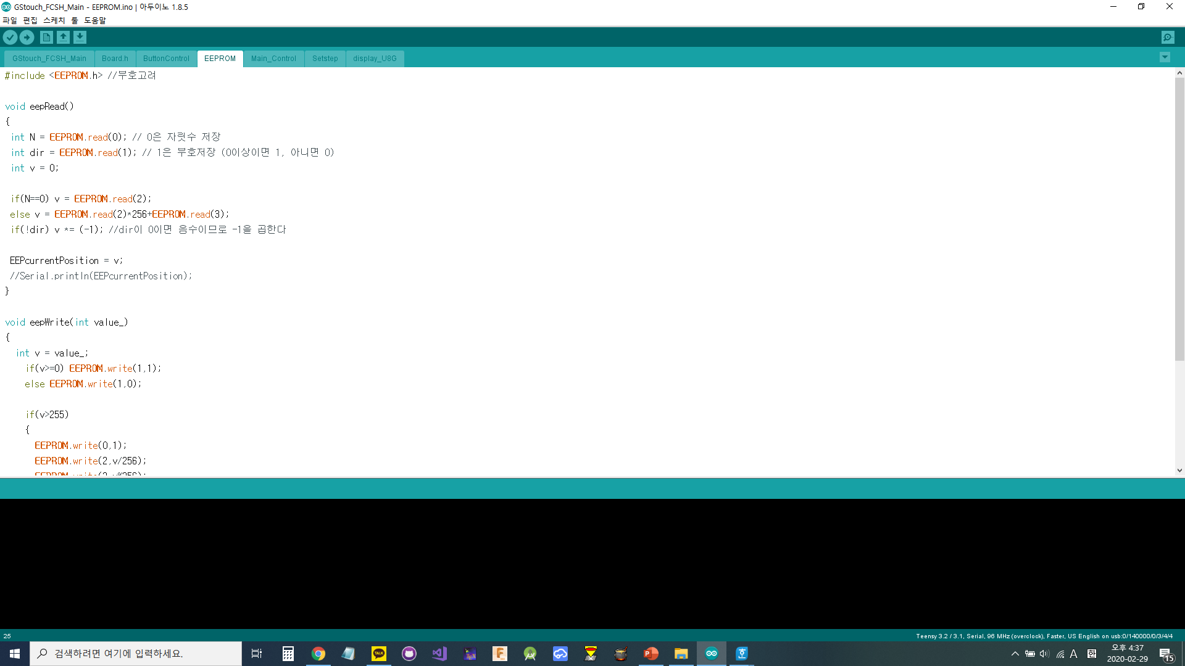
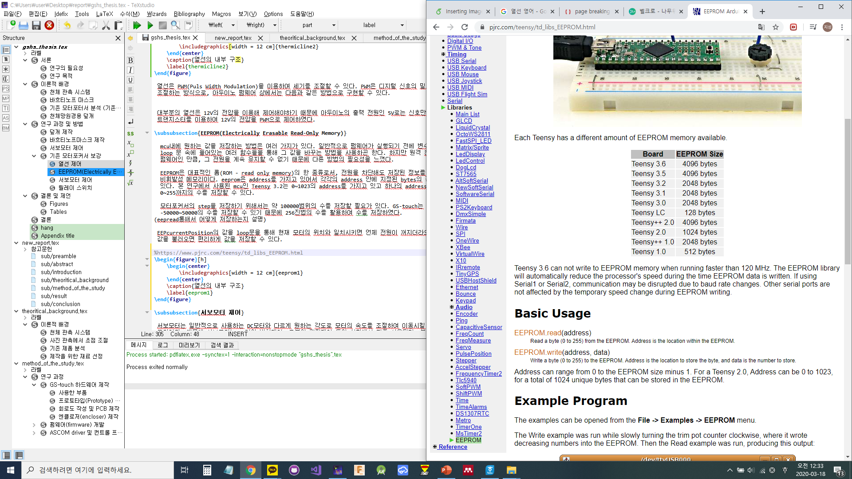
(Address=)0
1
2
3
Step 자릿수
Step
부호
256의
자리
1의
자리

Slide 2
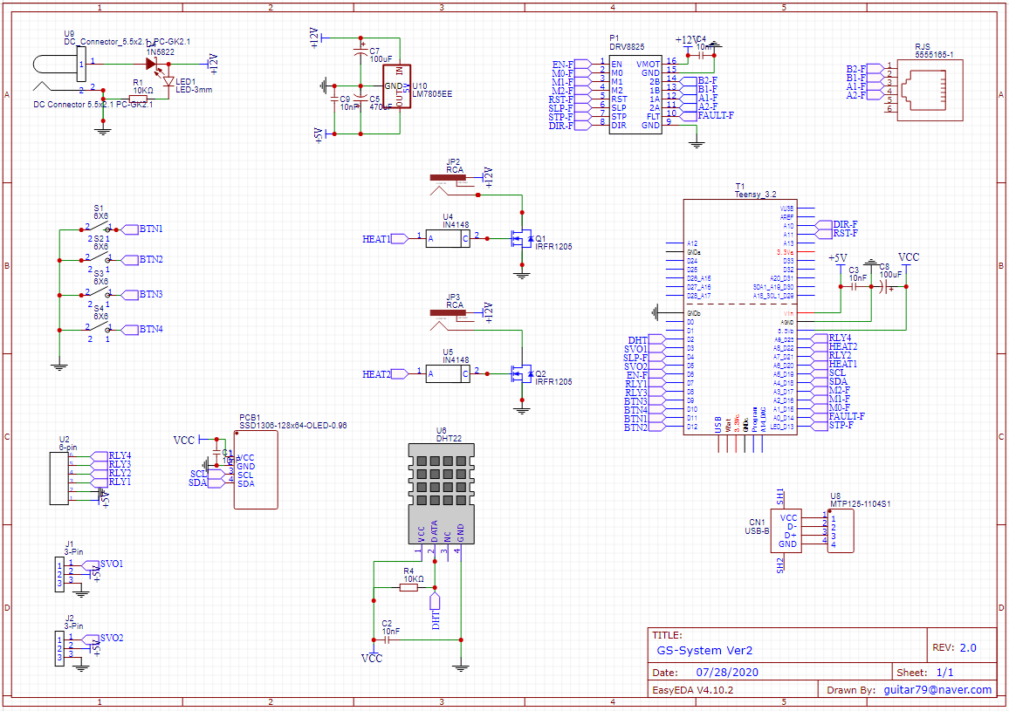

Slide 3
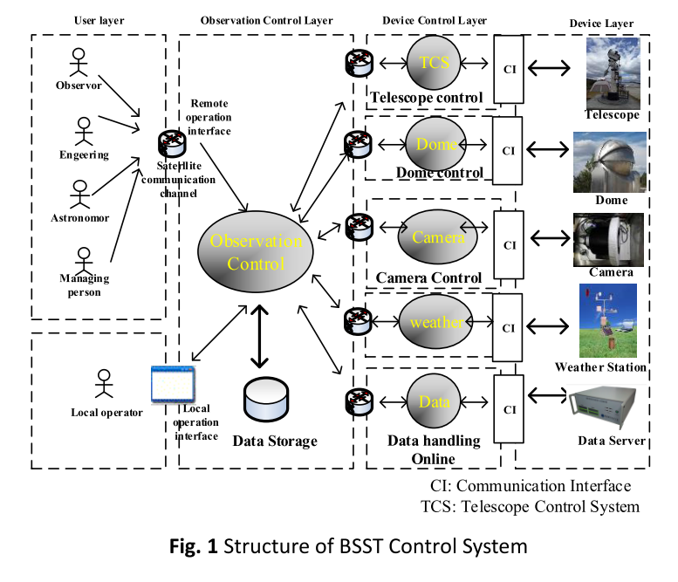
PC
GS-touch
Cover Control
Cover Control
ASCOM
Driver
Teensy 3.2
(MCU)
Power Control
Serial
Port
Power Control
Motor Focuser Control
ASCOM
Software
Firmware Hardware
Motor Focuser Control
INPUT
Thermic rays Control
Thermic rays Control
Sensors
Motor
Driver
OLED

Slide 4
PC
GS-touch
Cover Control
ASCOM
Driver
Teensy 3.2
(MCU)
Power Control
Serial
Port
Motor Focuser Control
INPUT
Driver GUI
Firmware Hardware
ASCOM Software
Thermic rays Control
Sensors
Motor
Driver
OLED

Slide 5
PC
Cover Control
ASCOM
Driver
Teensy 3.2
(MCU)
Power Control
Serial
Port
Motor Focuser Control
INPUT
Driver GUI
Firmware Hardware
ASCOM Software
Thermic rays Control
Sensors
Motor
Driver
OLED
Firmware Menu System
Status
Motor Control
Motor Control
Position
Temperature
Humidty
Microstepping
PC connection
Motor Power
Firmware Menu System
Motor Setting
Microstepping
Position Reset
Status
Motor Control
Motor Control
Servo & Relay
Control
Cover Control
Position
Temperature
Humidty
Microstepping
PC connection
Motor Power
Relay Control
Motor Setting
Microstepping
Position Reset
Servo & Relay
Control
Cover Control
Relay Control

Slide 6
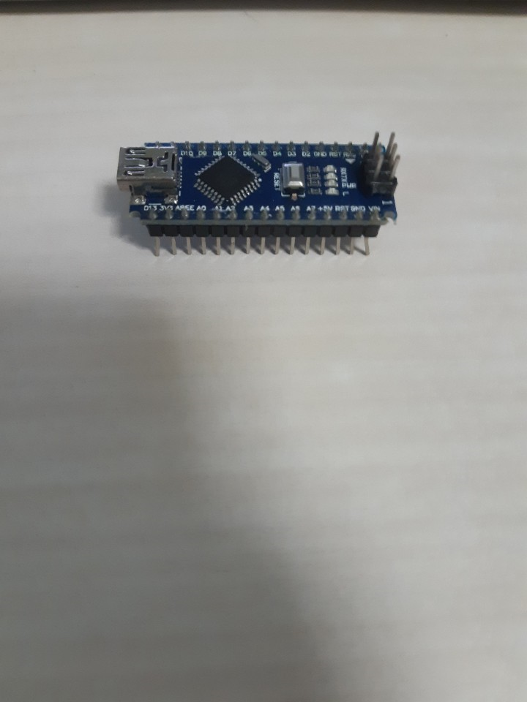
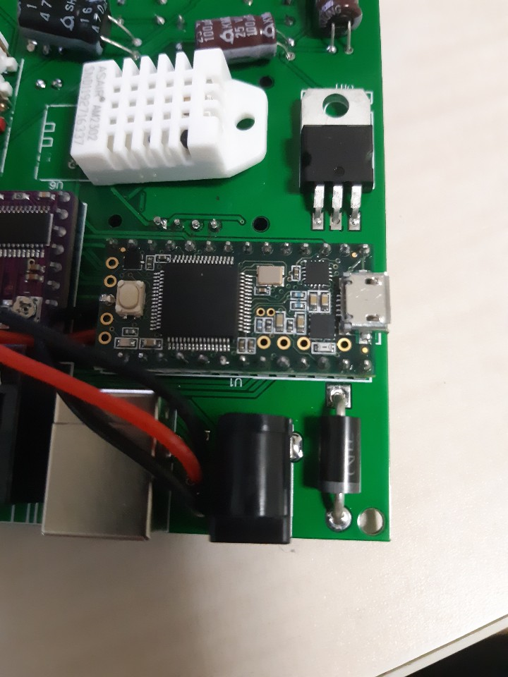

Slide 7
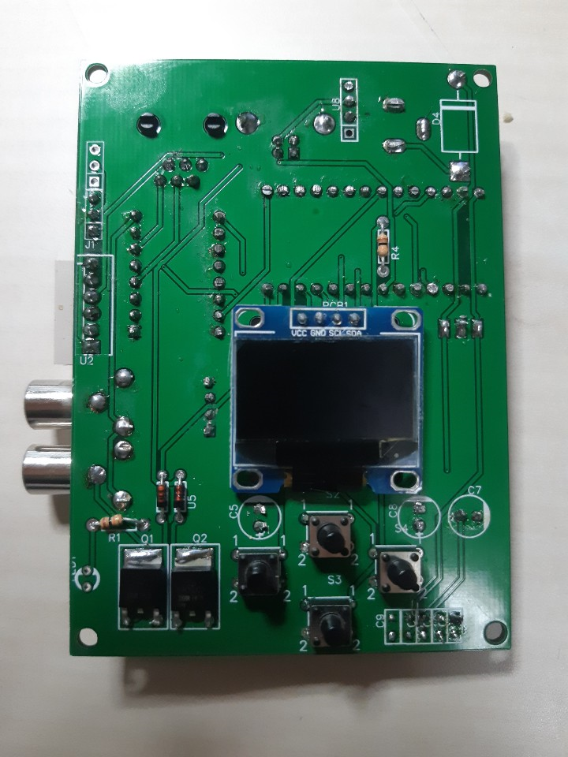
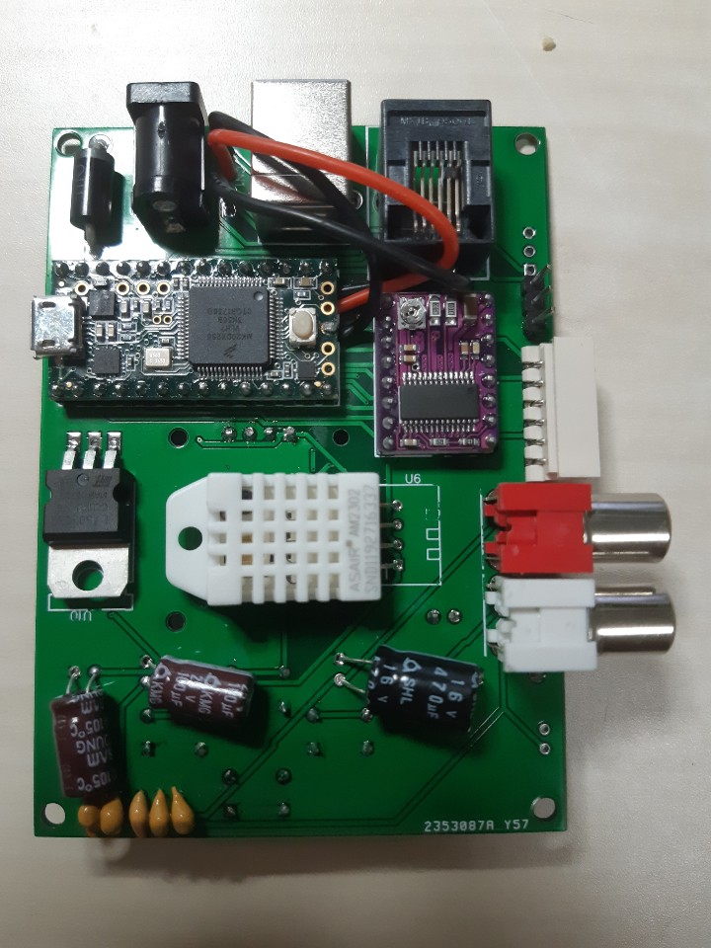

Slide 8
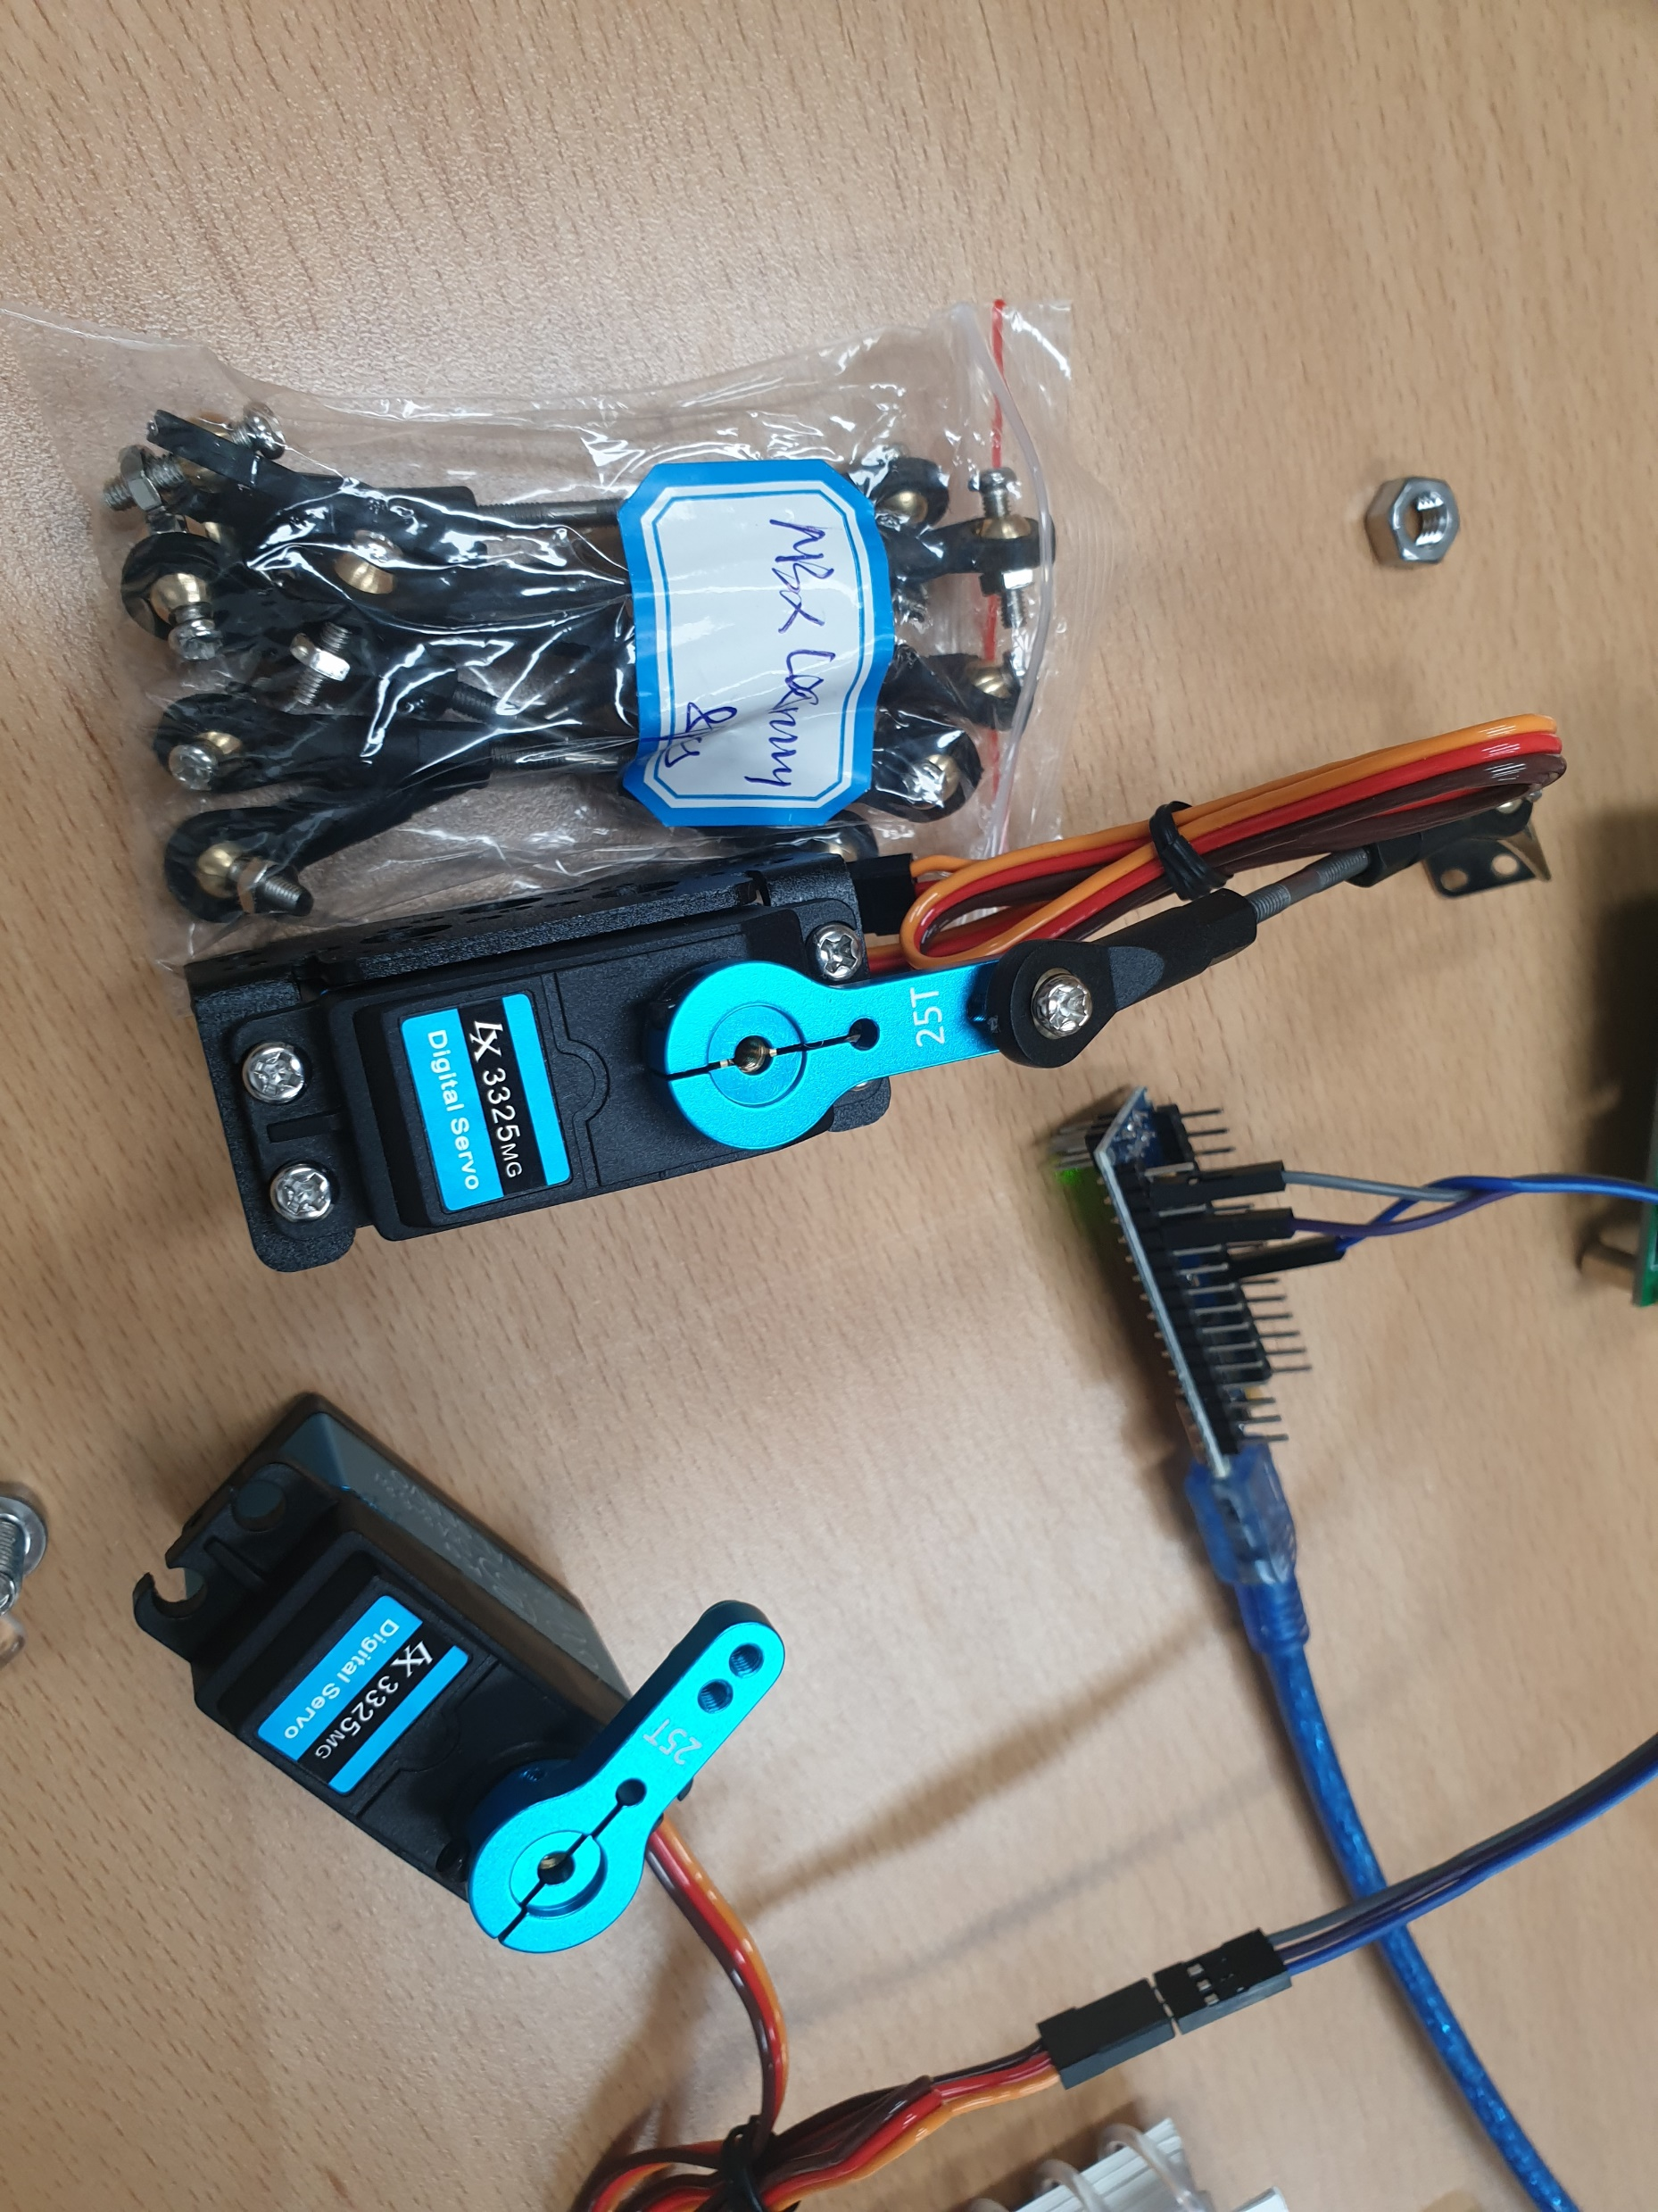
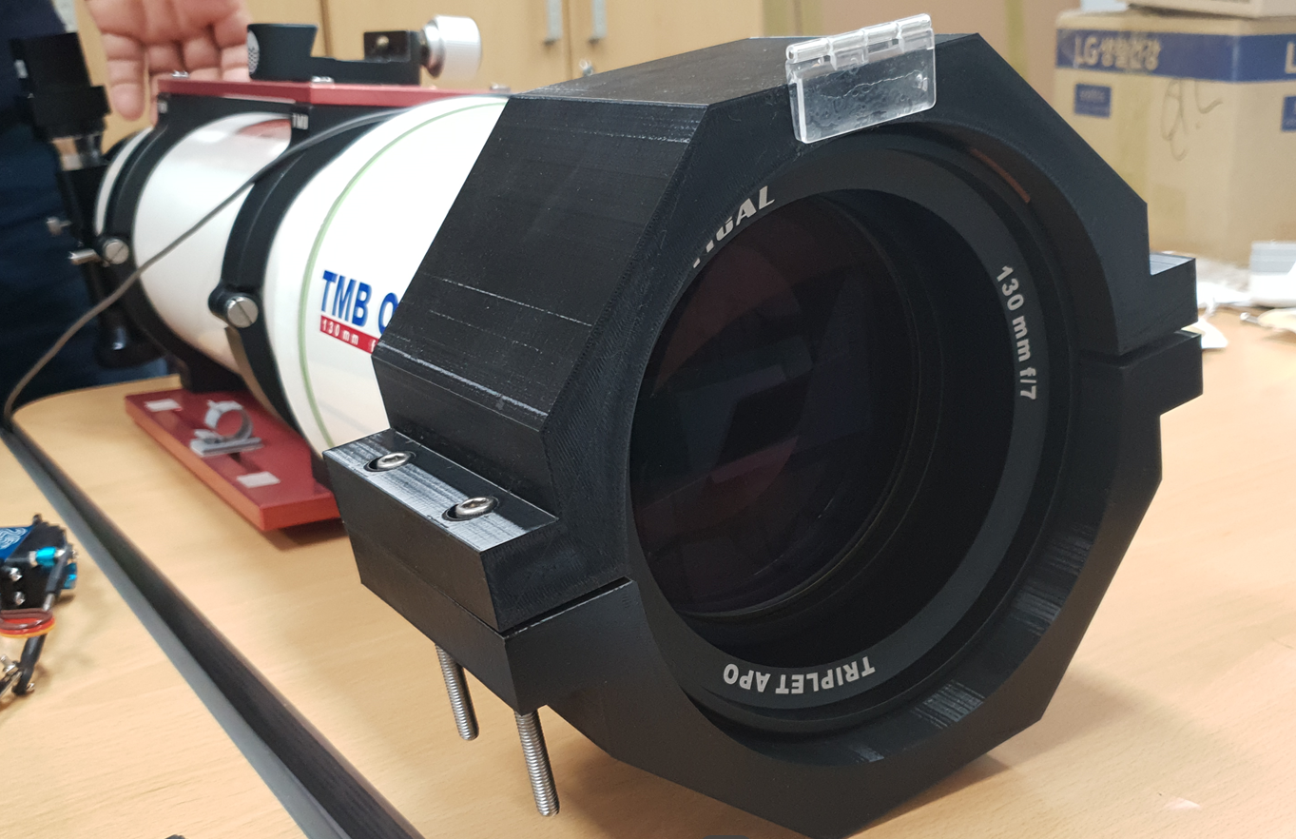

Slide 9
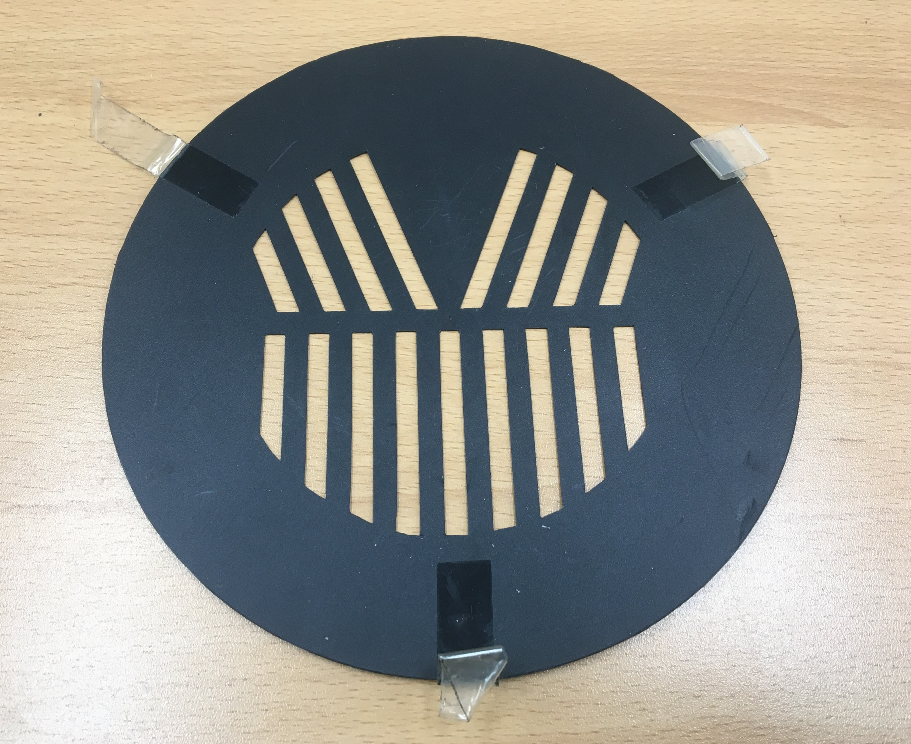

Slide 10
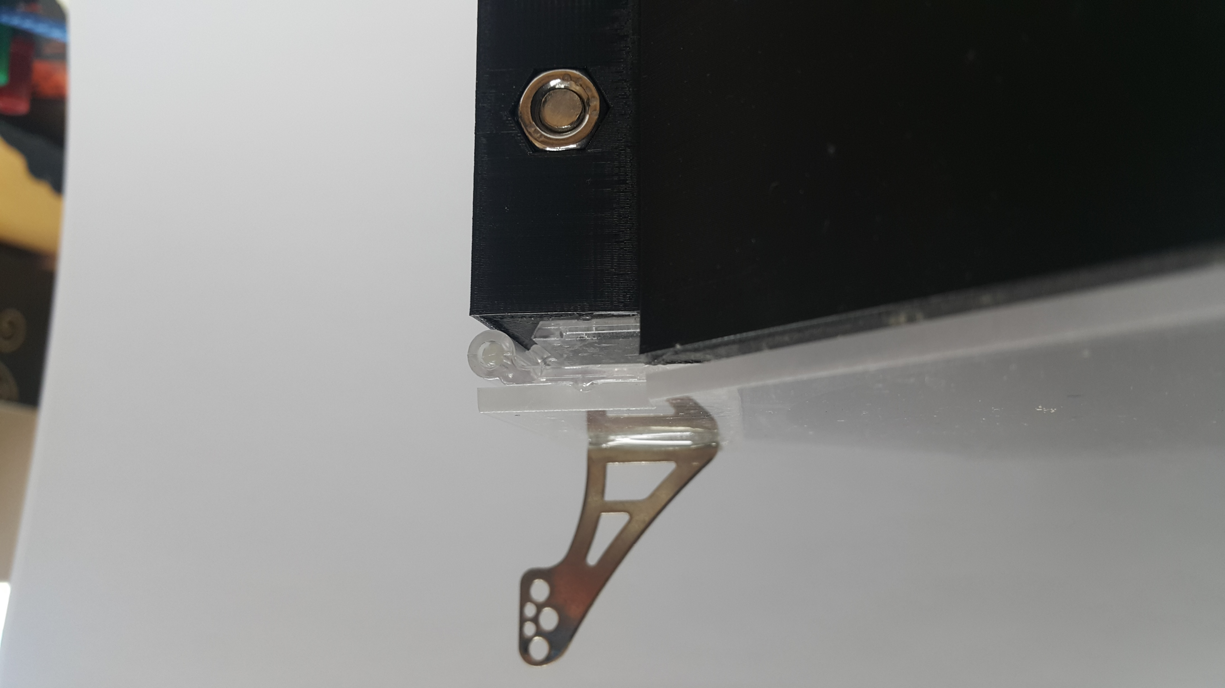
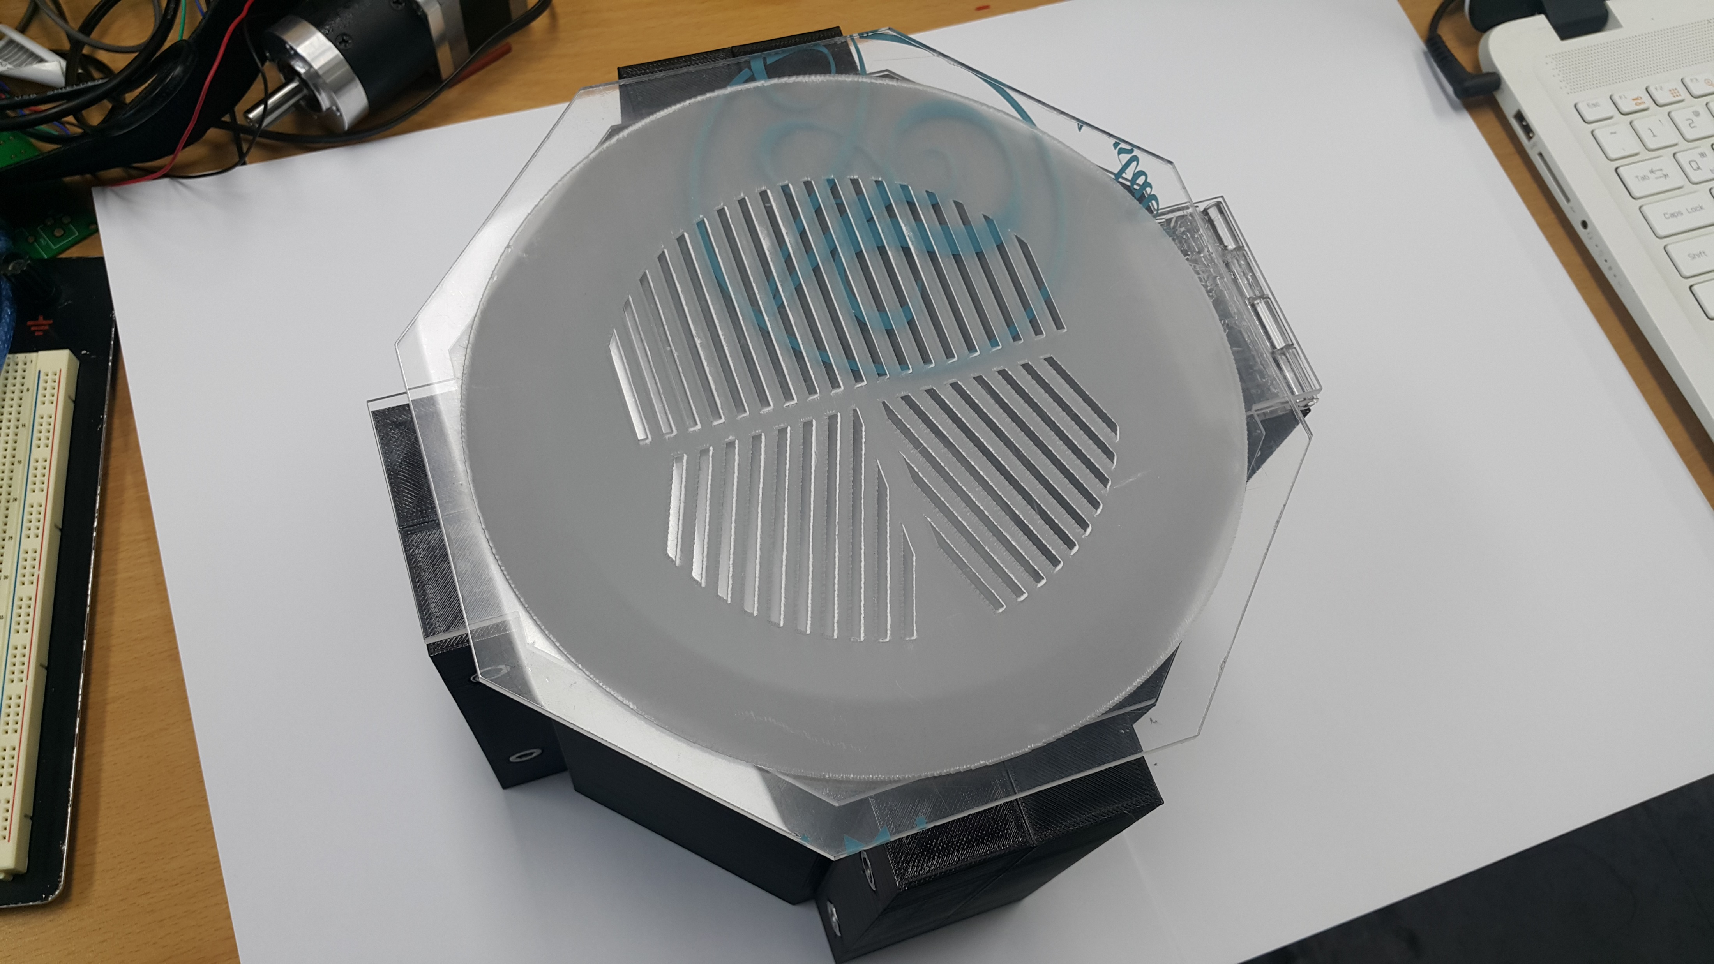
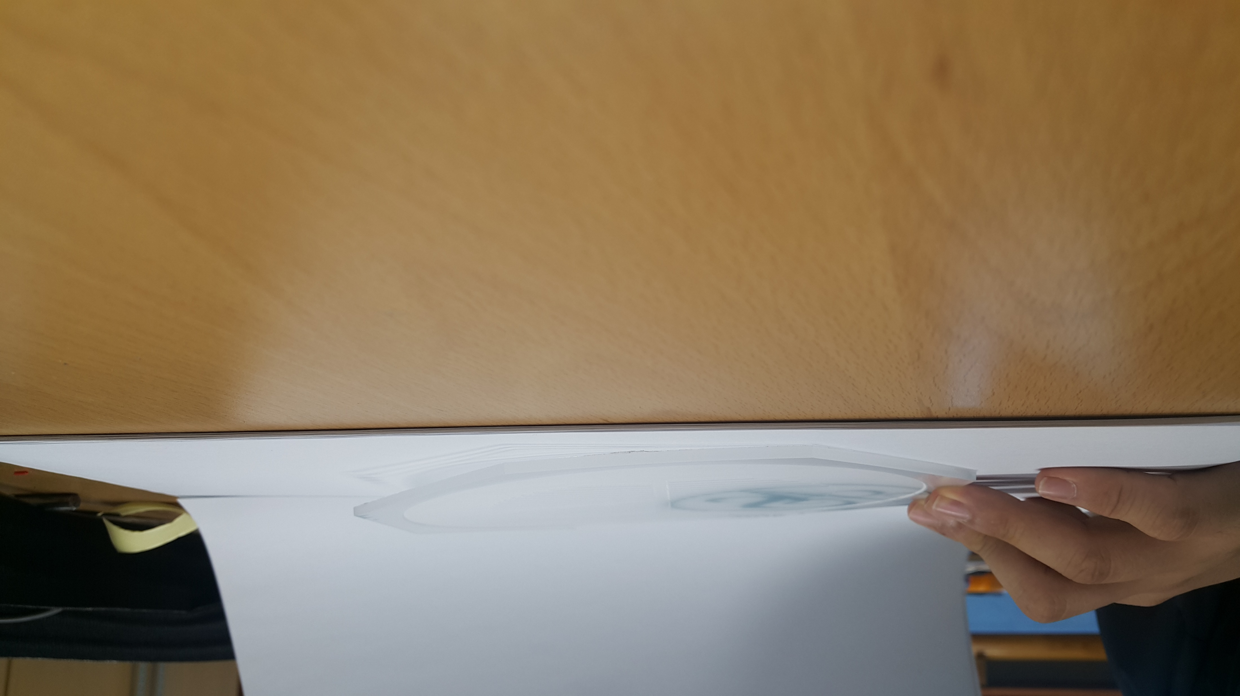

Slide 11
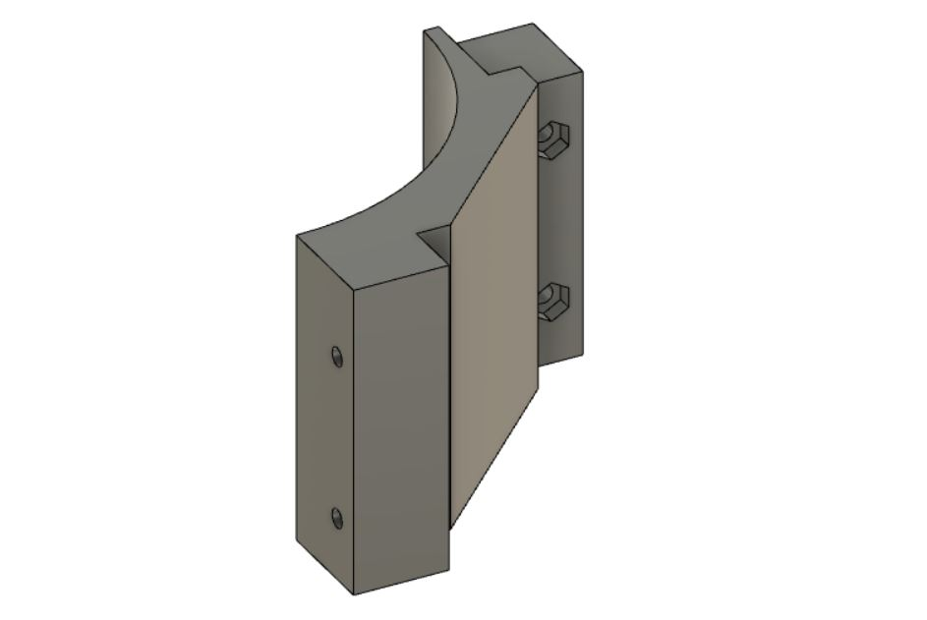
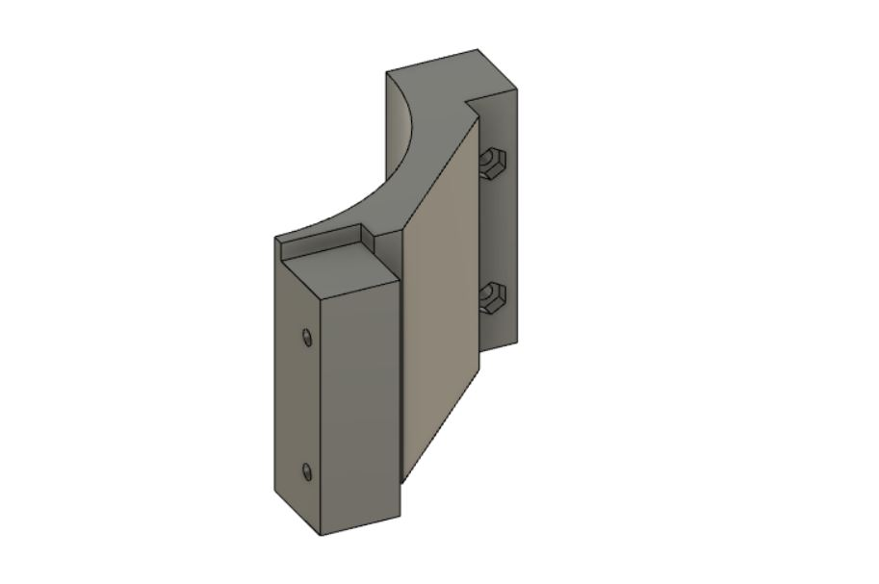

Slide 12
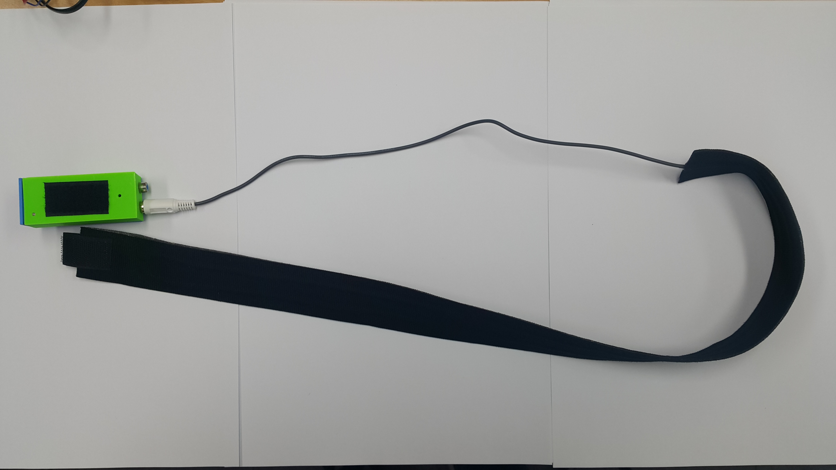

Slide 13
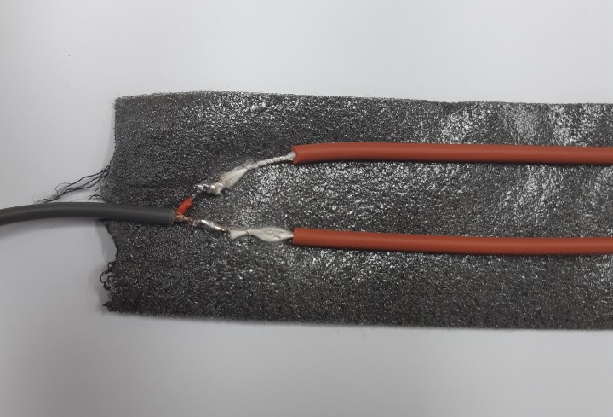

Slide 14
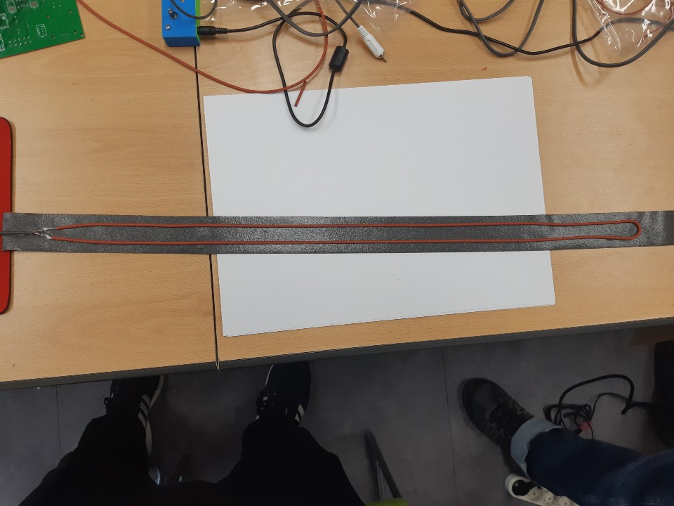

Slide 15
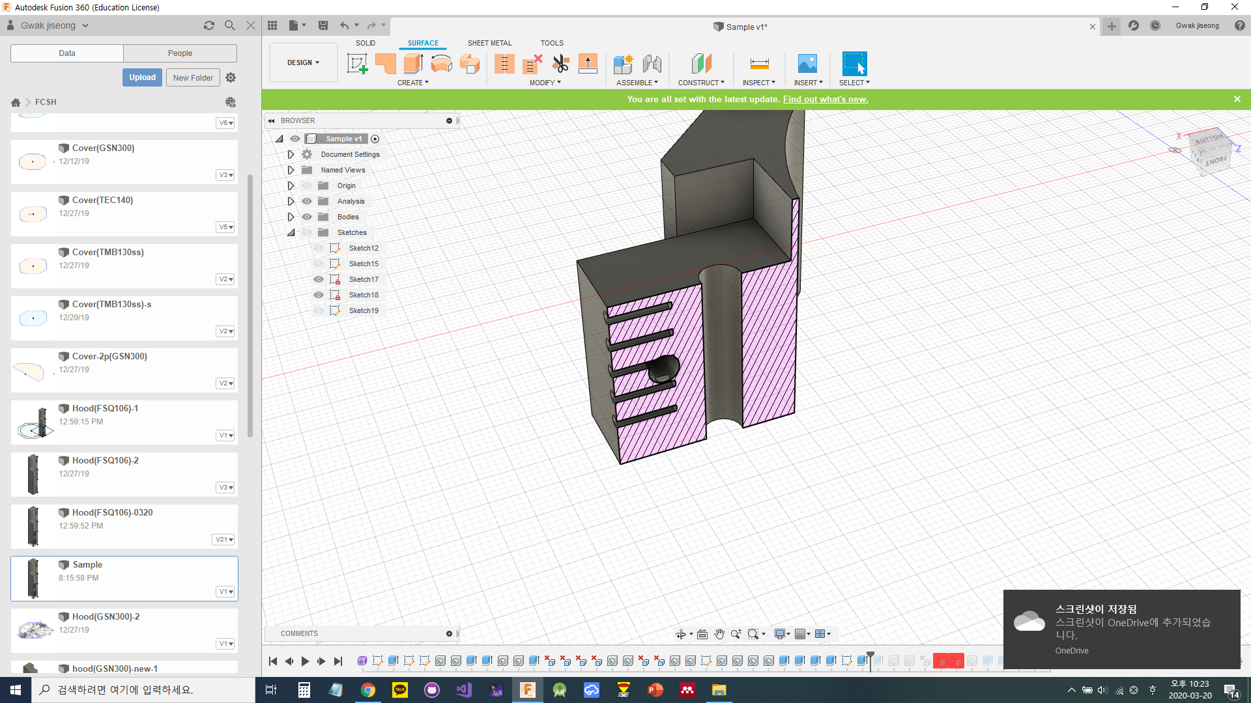

Slide 16
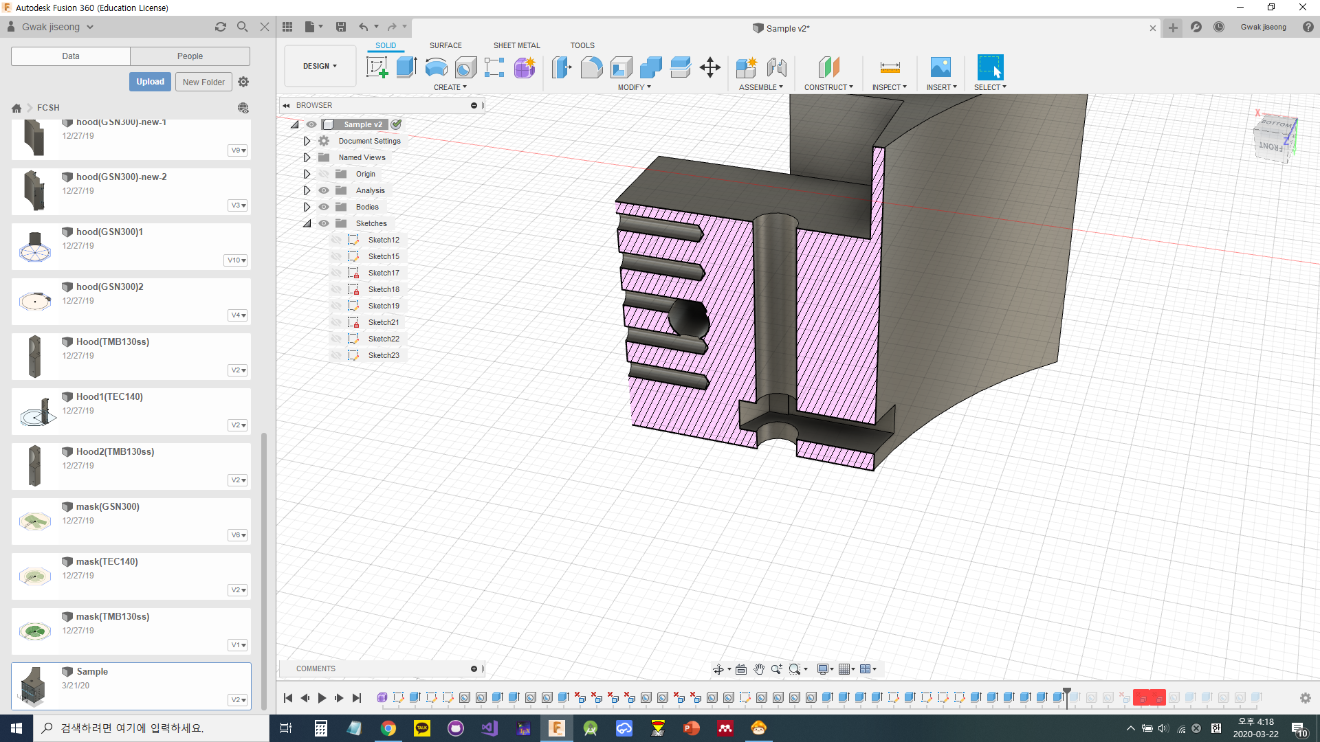

Slide 17
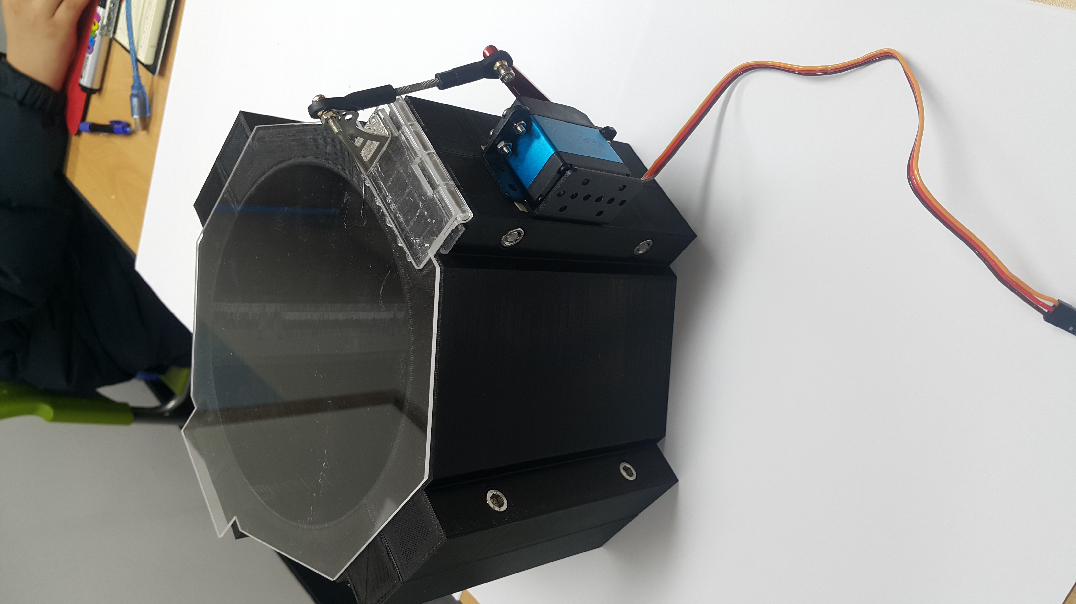

Slide 18
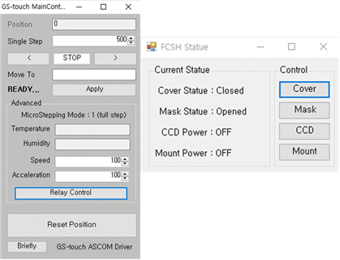
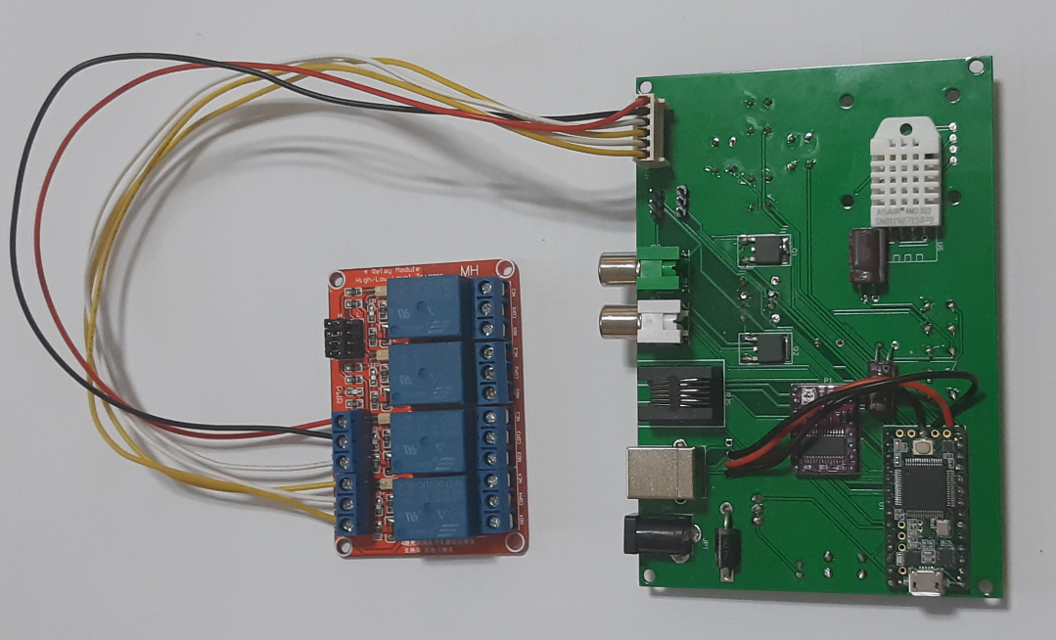

Slide 19
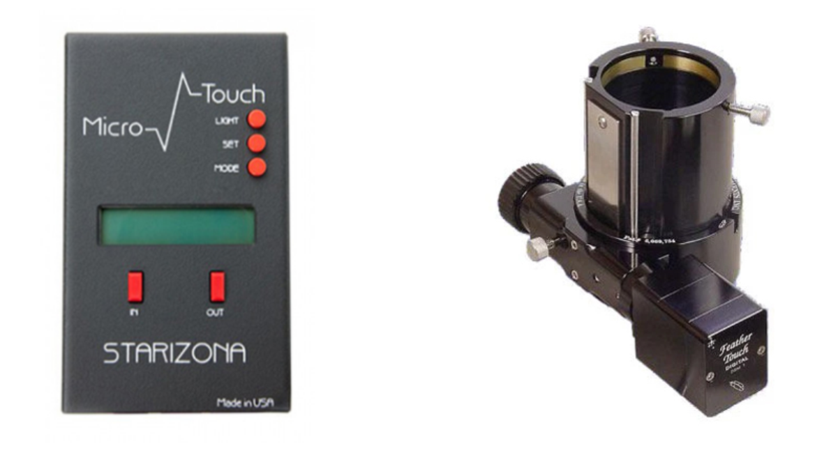

Slide 20
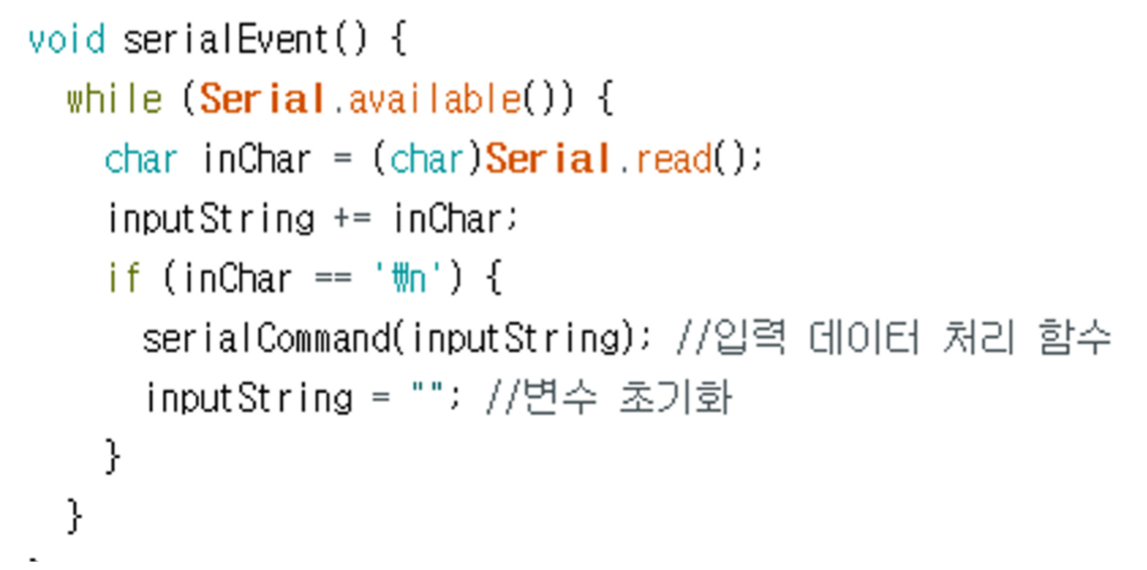

Slide 21
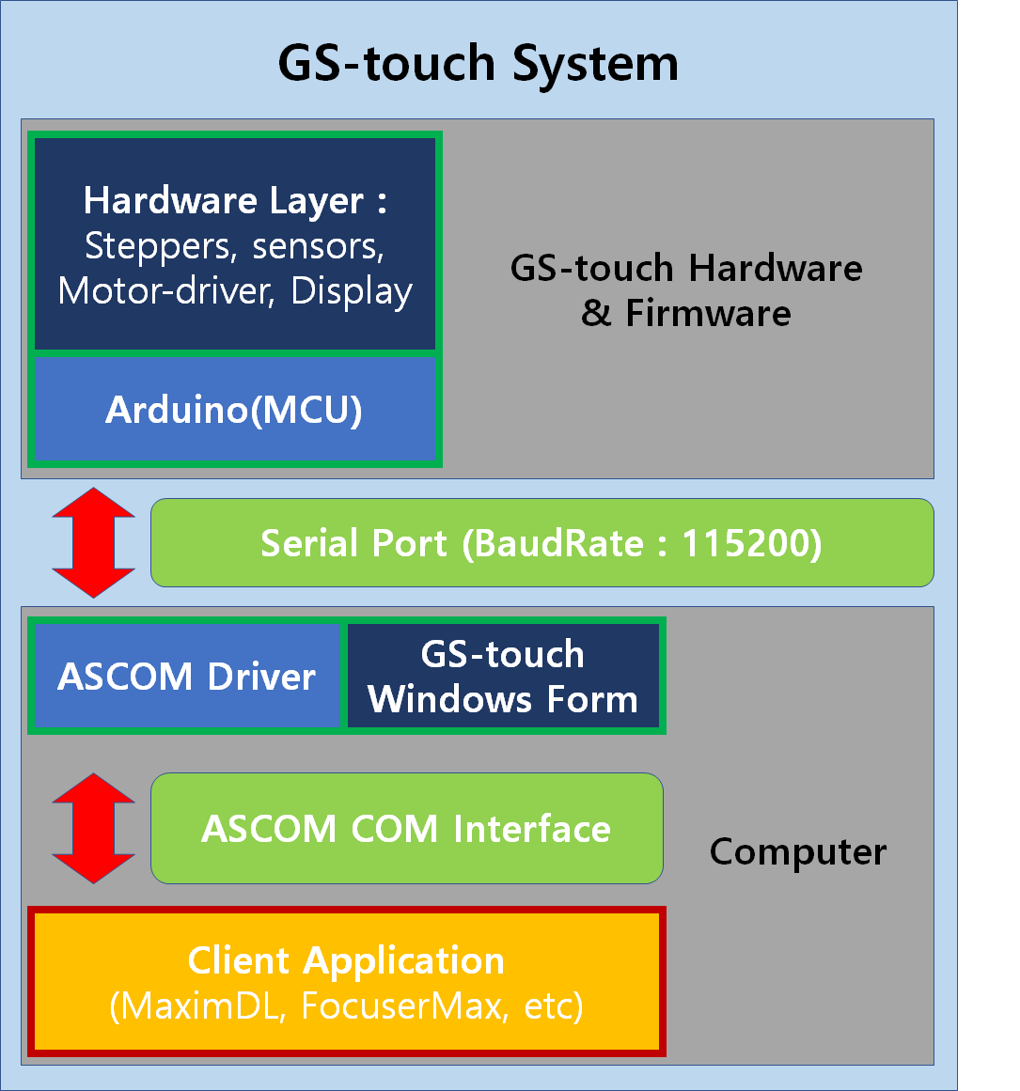
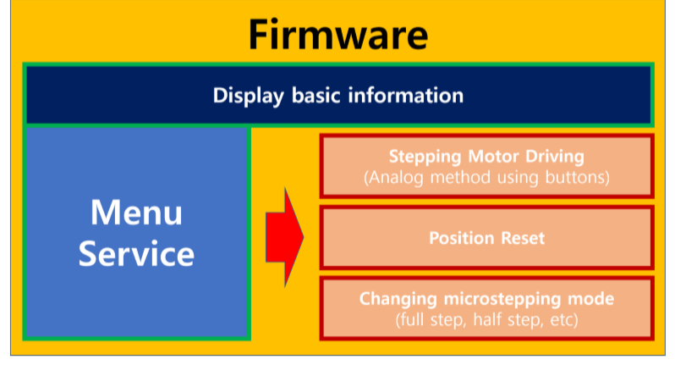

Slide 22
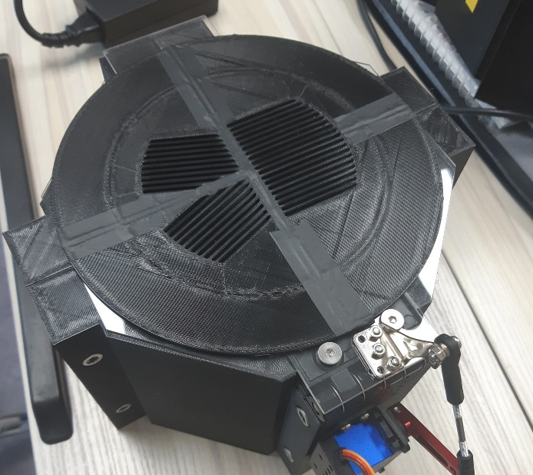

Slide 23
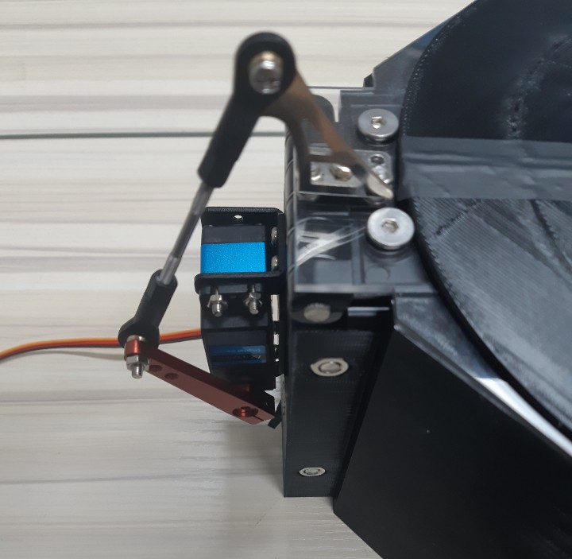

Slide 24
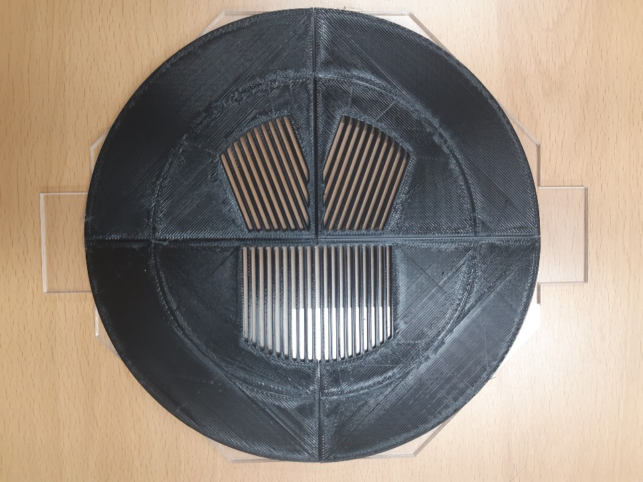

Slide 25
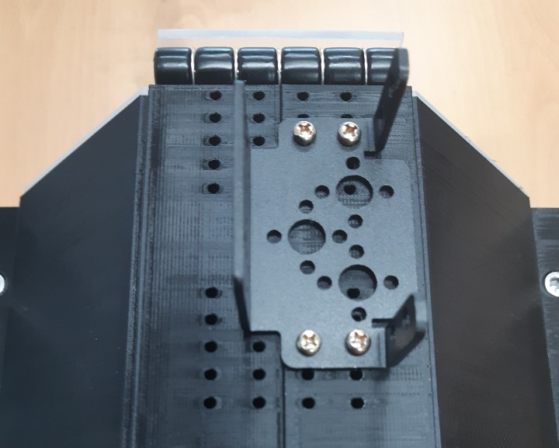

Slide 26
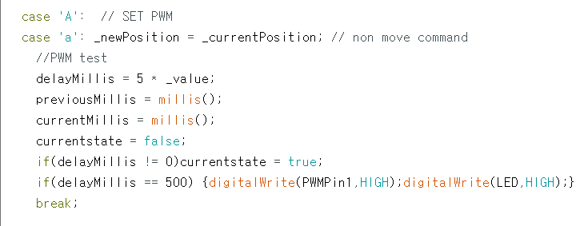

Slide 27
